Slide 1







REGRESSION OF USED CAR PRICES
Team 1
Ahmed Shaltot
John Ashraf
Abdo Rateb
Maritte Magdy
Mohamed Hossam
Mohamed Mohab

Slide 2

REGRESSION OF USED CAR PRICES
Kaggle competition
Stage 1
Exploration
Stage 2
01
visualization
02
Stage 5
05
Model evaluation
Stage 3
03
Preprocessing
04
Stage 4
Model selection

Slide 3
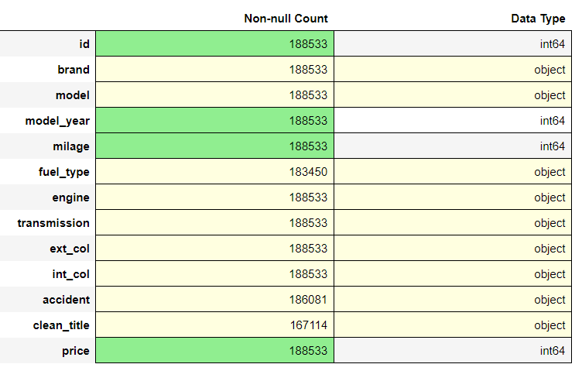

Stage 1
Exploration
The goal of this competition is to predict the price of used cars based on various attributes.
Dataset Description
.

Slide 4
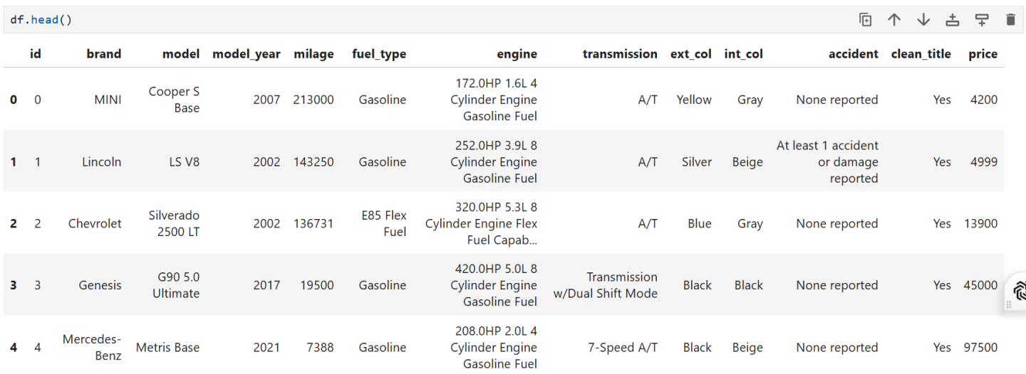
function in Pandas is a handy tool for quickly inspecting the first few rows of a DataFrame. Here’s a breakdown of how it works and why it’s useful:

Slide 5
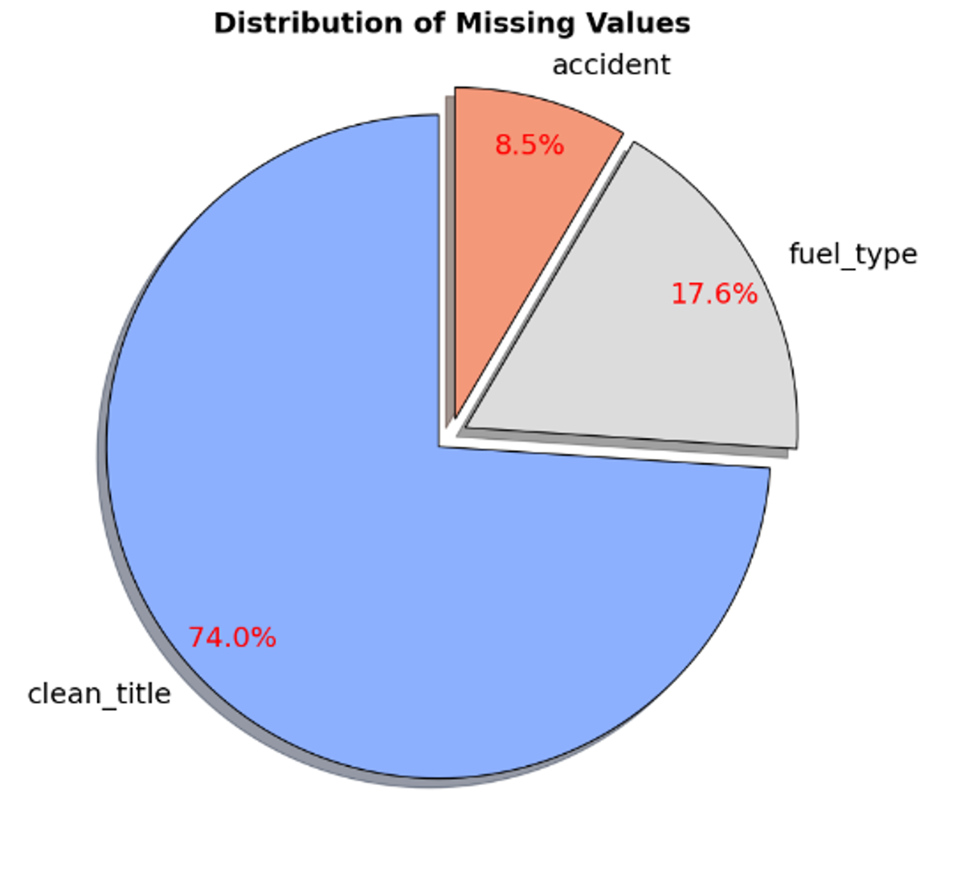
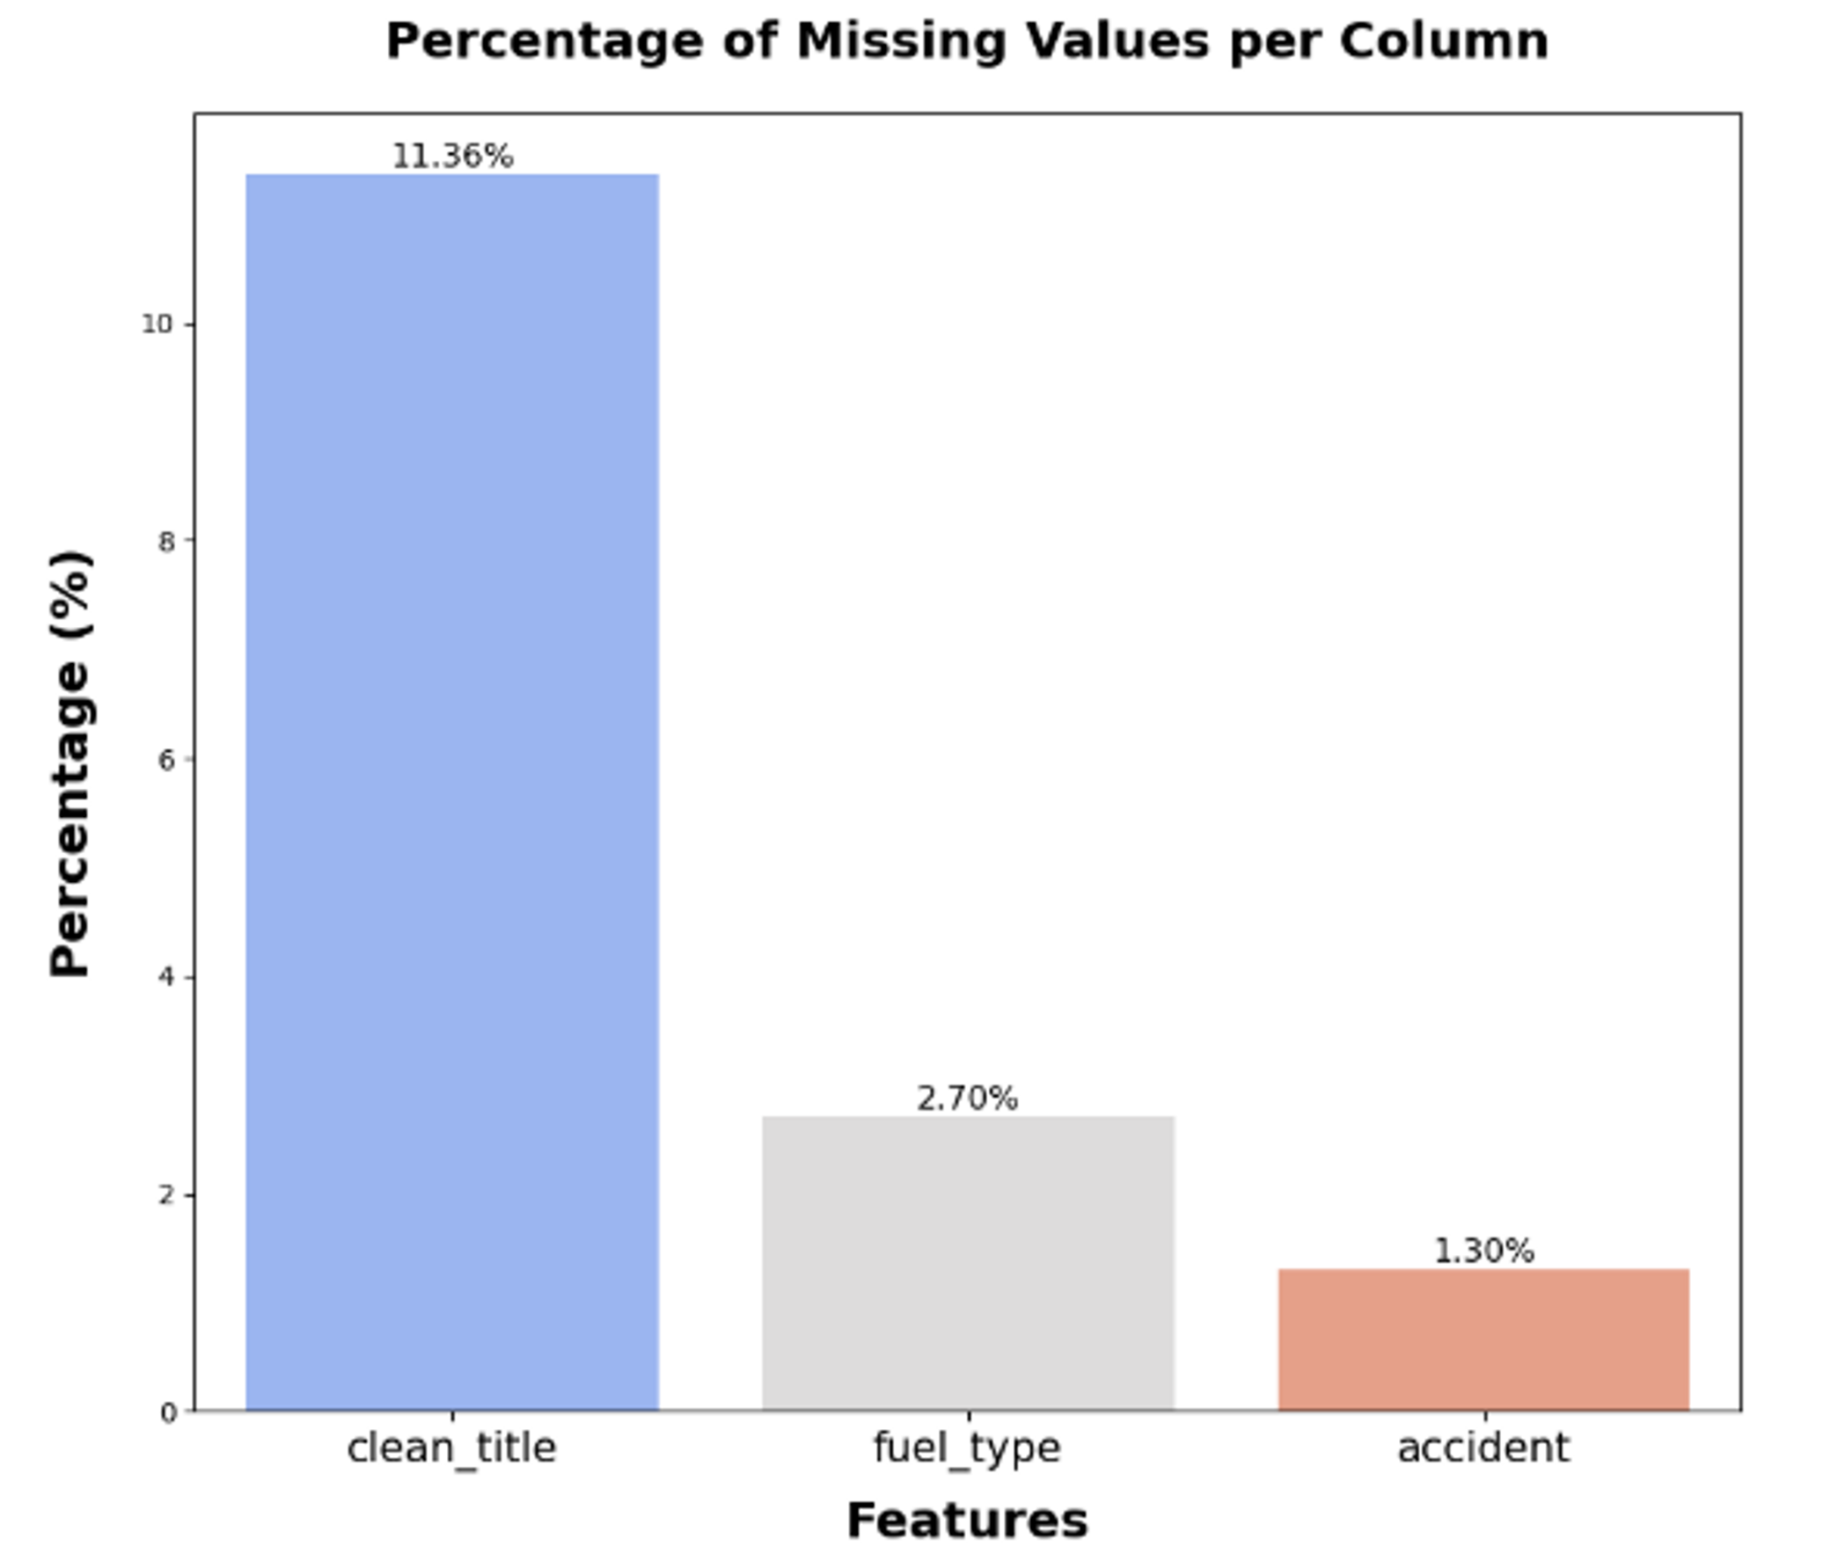
Exploration

Slide 6
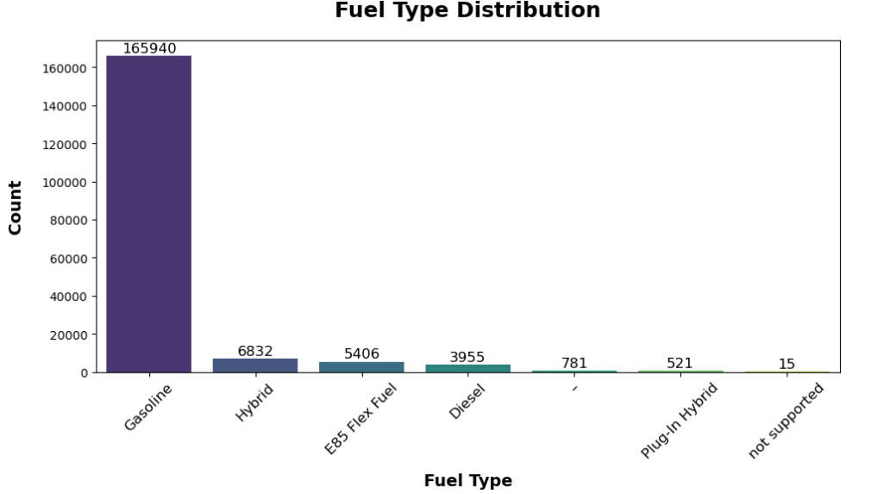
diving in each column to extract insights
fuel_type
other than nulls there were values like (- ,not supported)

Slide 7
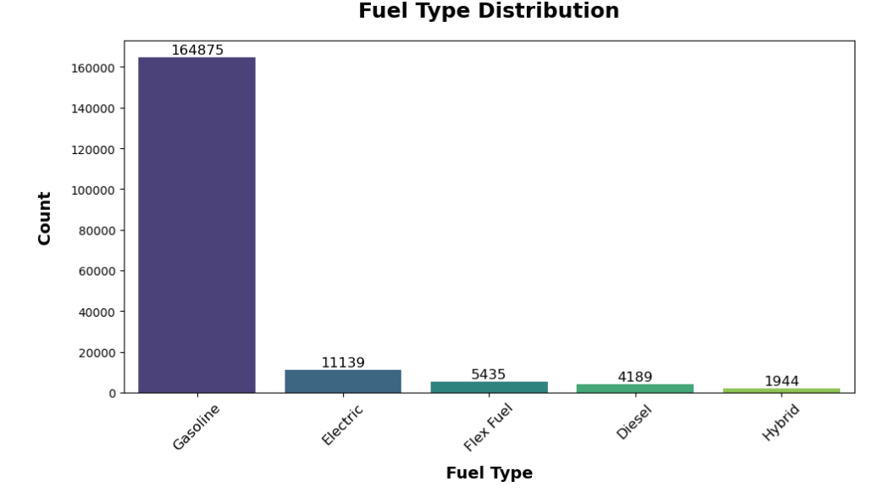
fuel_type
after processing and filling nulls from engine column

Slide 8
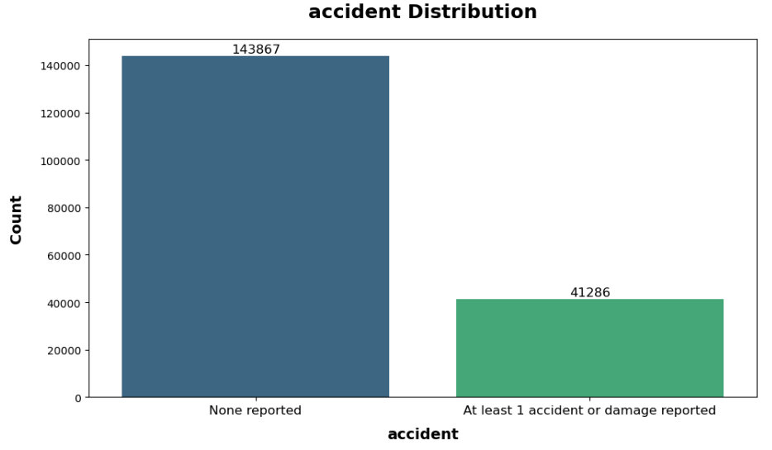
accident
this column contains only 2452 null value
we dropped rows containing nulls in that column

Slide 9
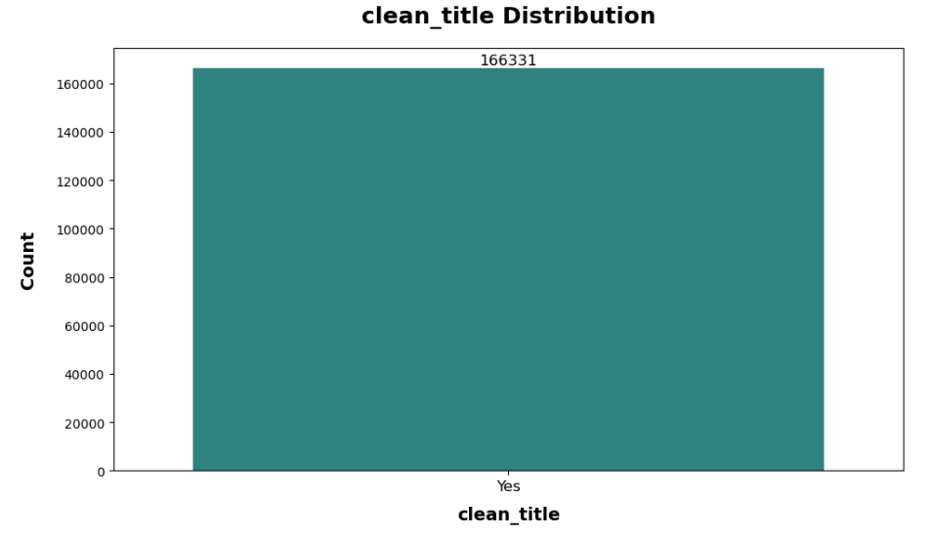
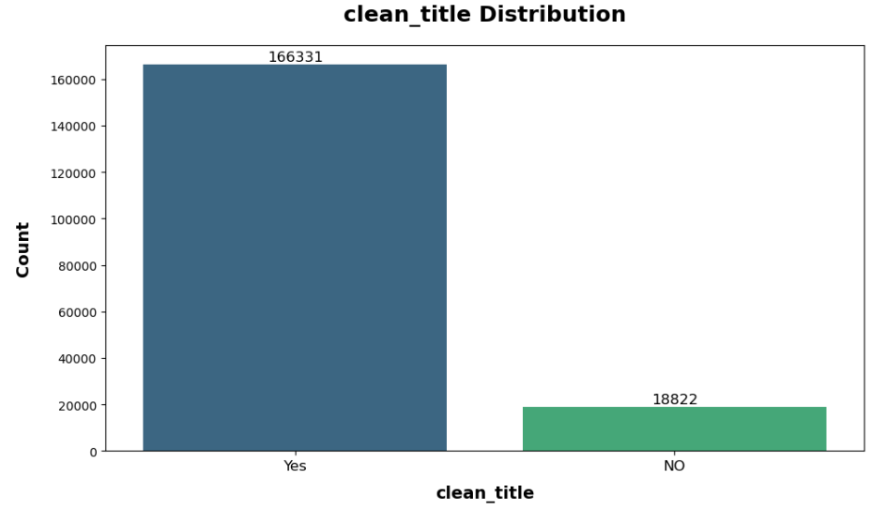
clean_title
we realized that all missing values in that column cars with pervious accident history
we filled null values with NO

Slide 10
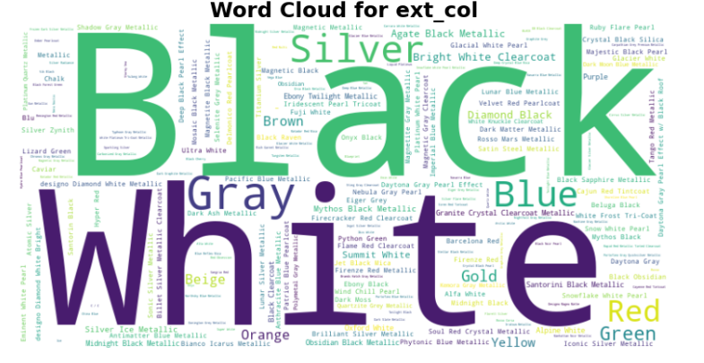
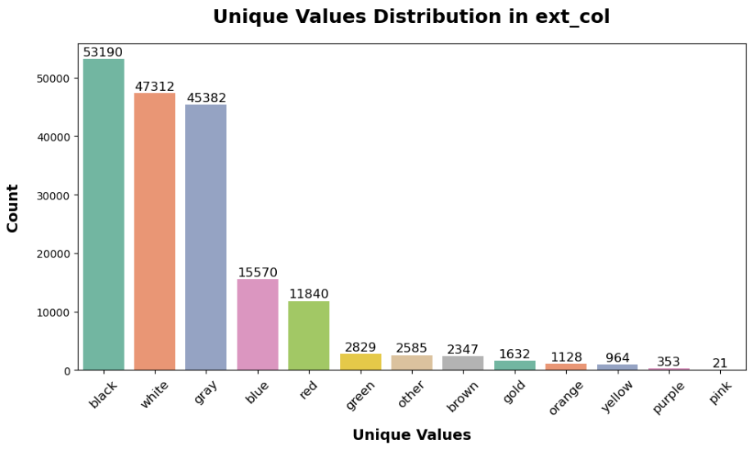
ext_color
we had more than 150 unique value so we standardized this column to only 14 value
after processing

Slide 11
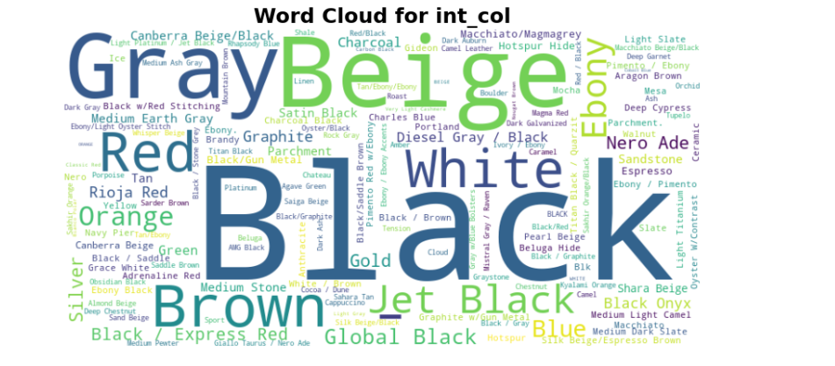
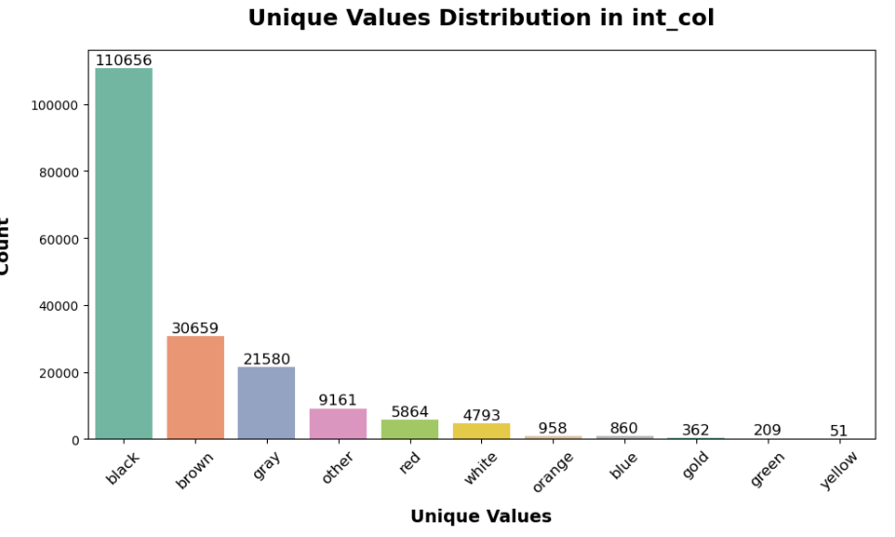
int_color
same for internal color column
after processing

Slide 12
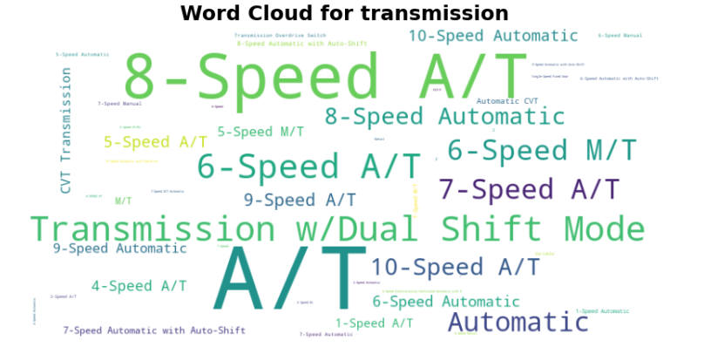
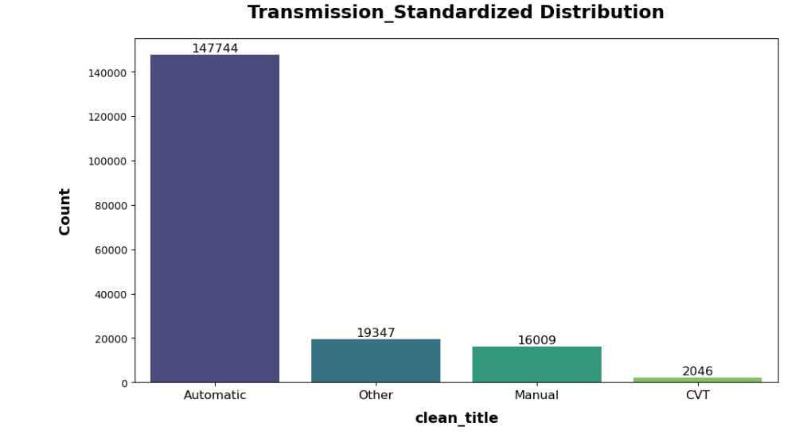
transmission
we had 52 unique value so we standardized this column to only 4 value
after processing

Slide 13
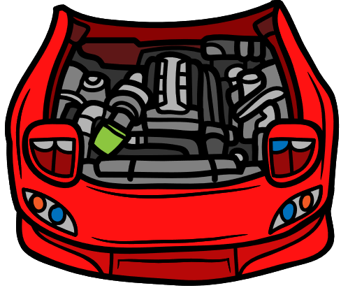
engine
features of engines
cylinders
engine_size
horsepower
missing values
horsepower 31500
engine_size 13175
cylinders 36049
we filled nulls with mean of values for each car model

Slide 14
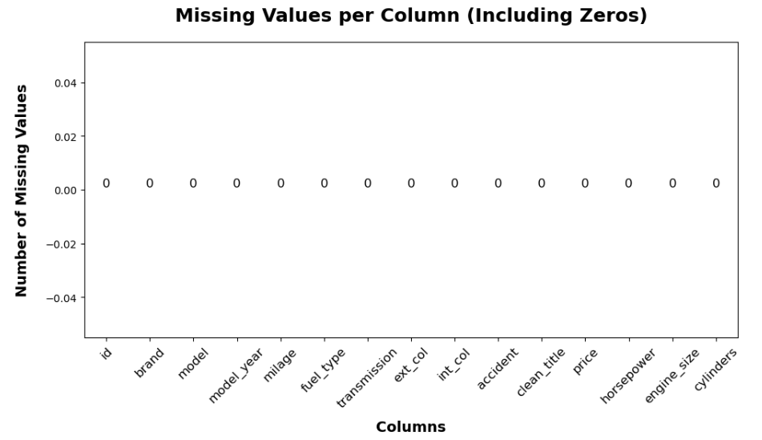

Slide 15
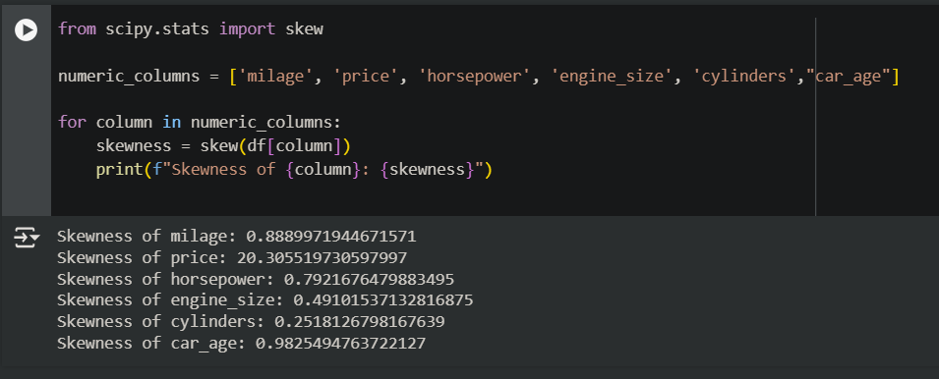
Testing Skewness

Slide 16
Applying Various Transformations
Log Transformation
Boxcox Transformation
Square Root Transformation
Cube Root Transformation

Slide 17
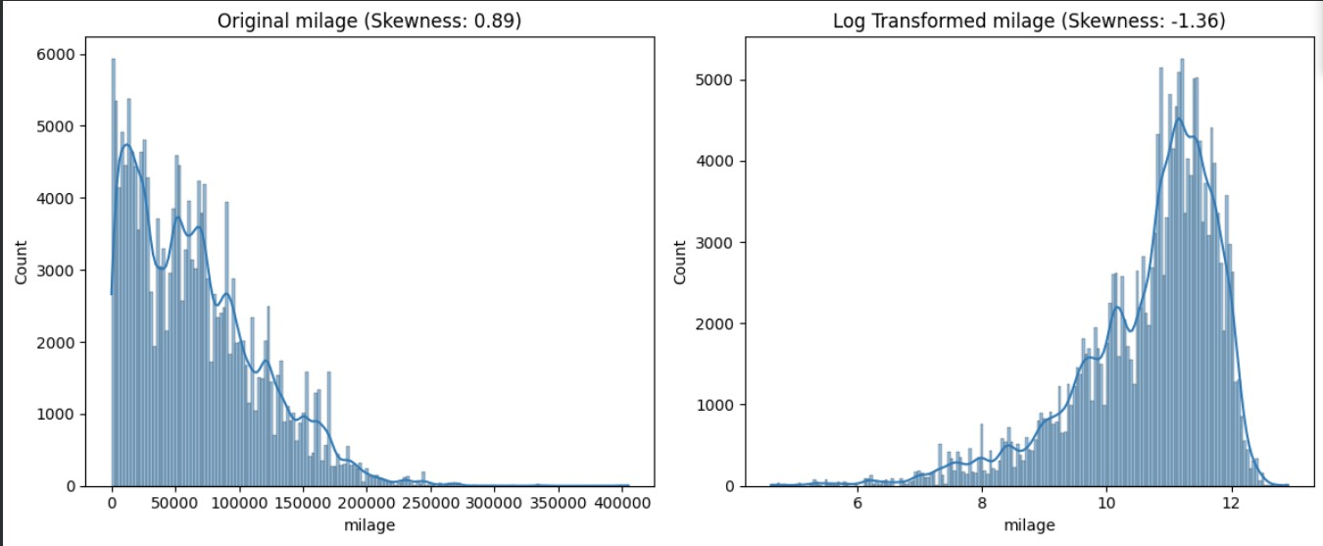
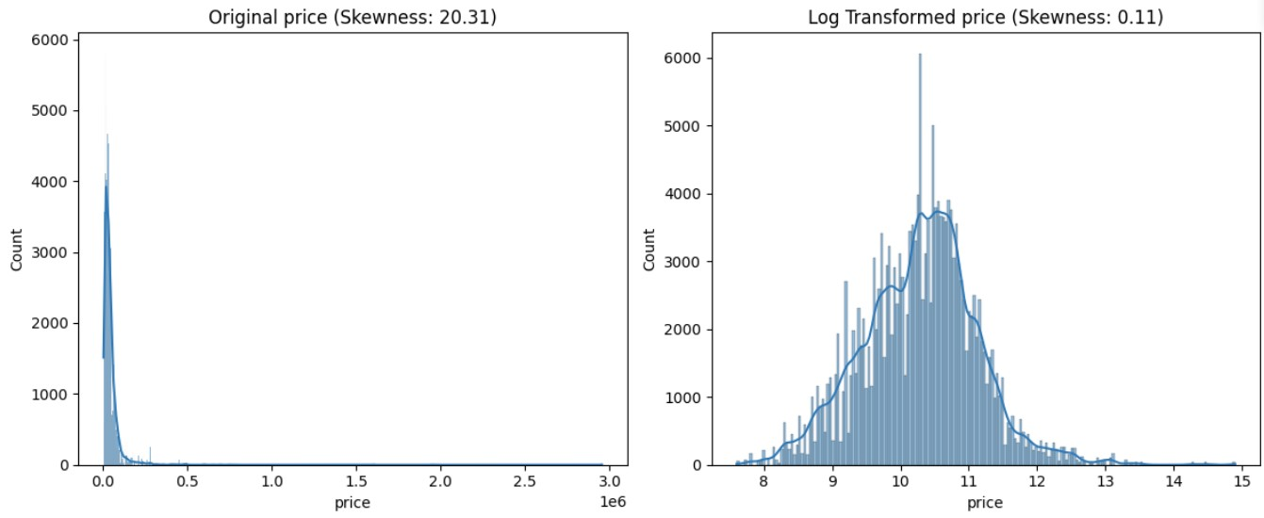
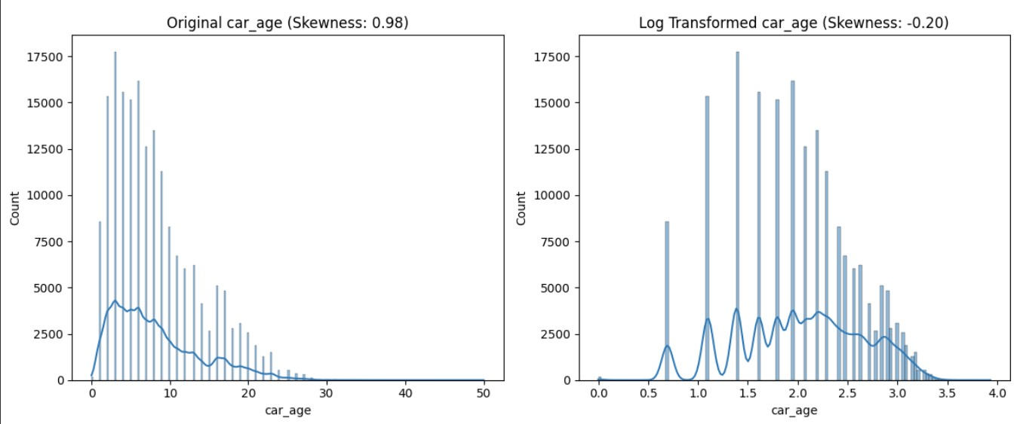
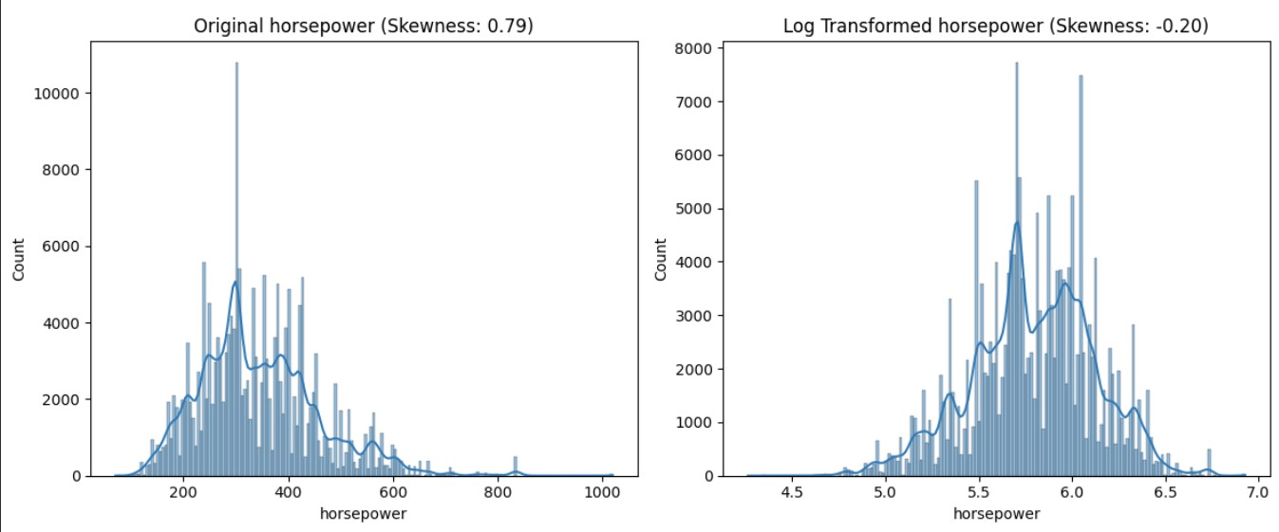
Log
Transformation

Slide 18
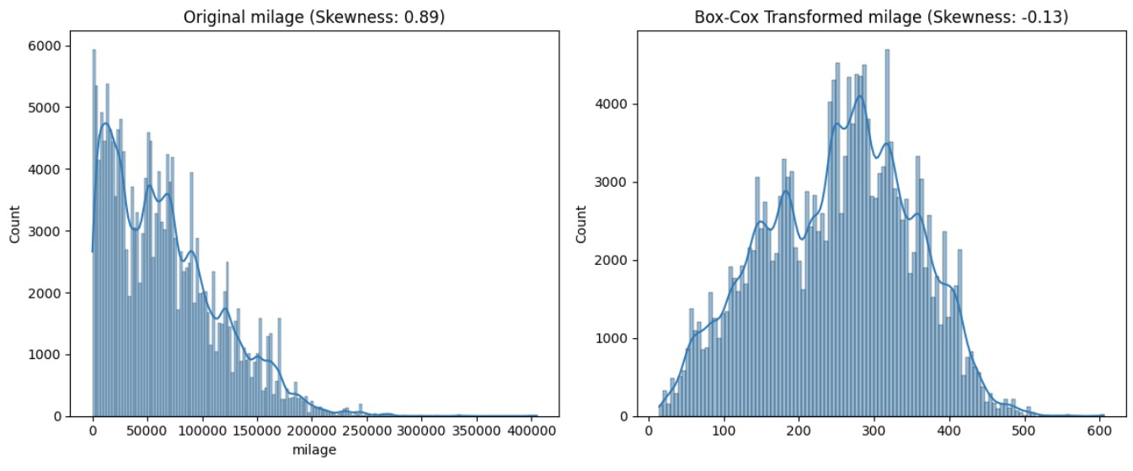
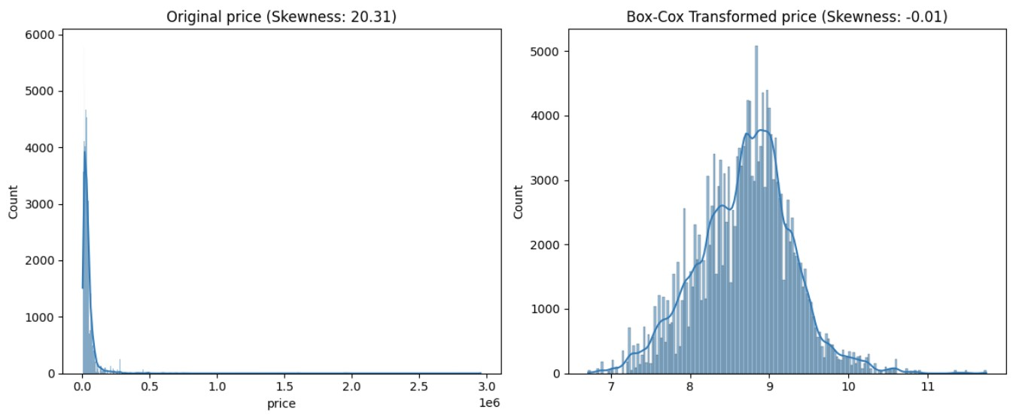
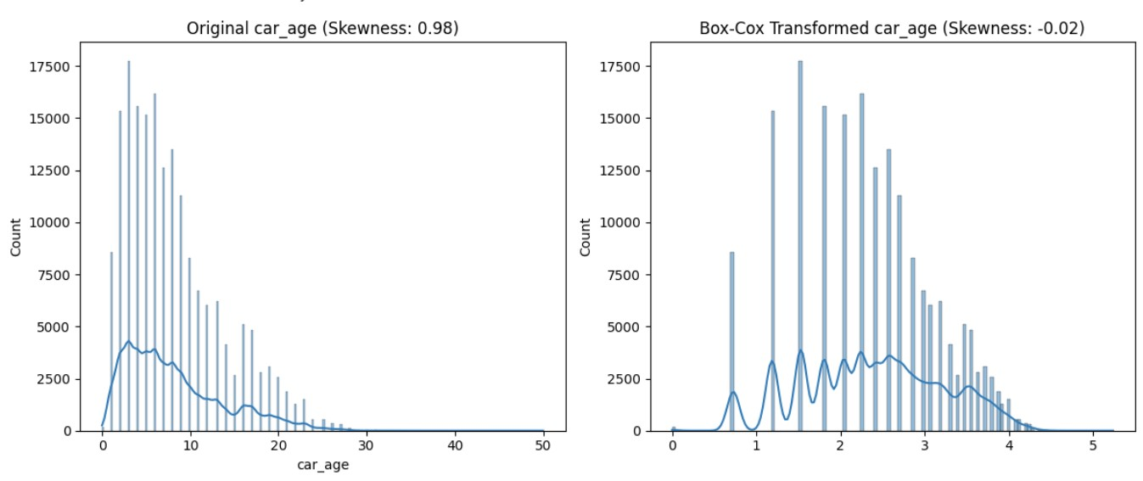
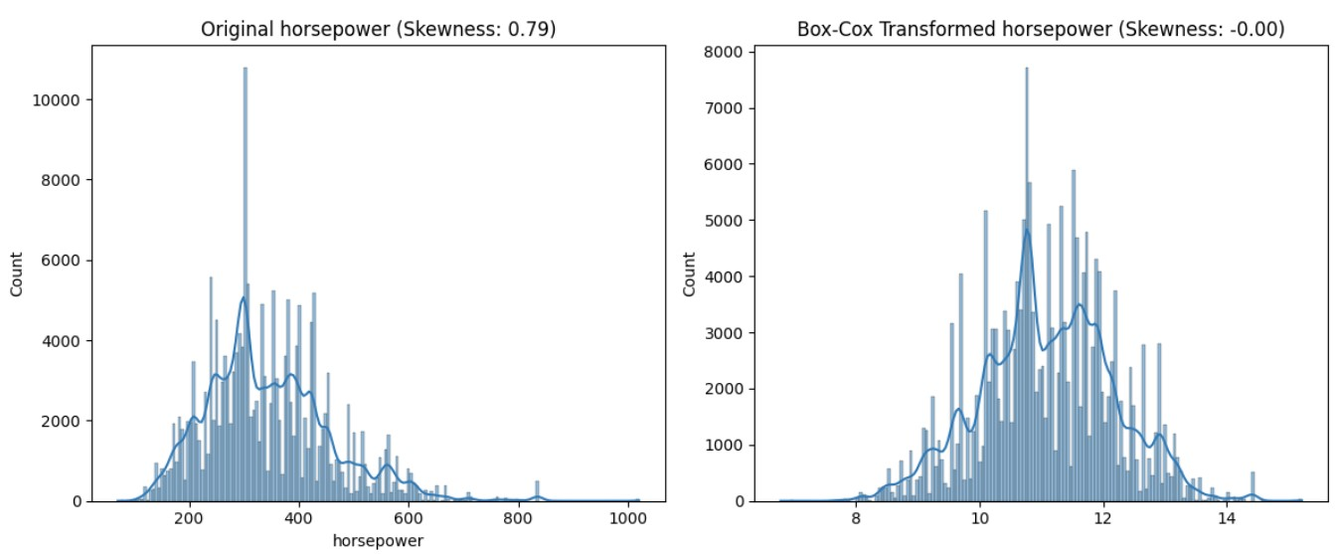
BOXCOX
Transformation

Slide 19
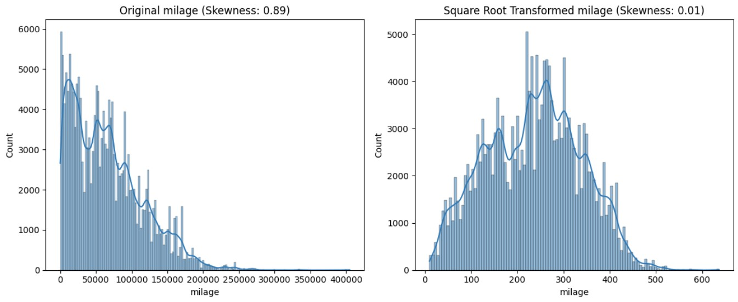
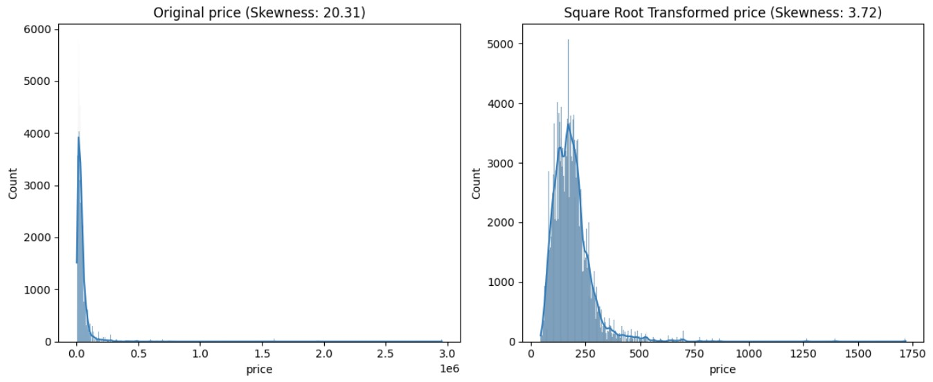
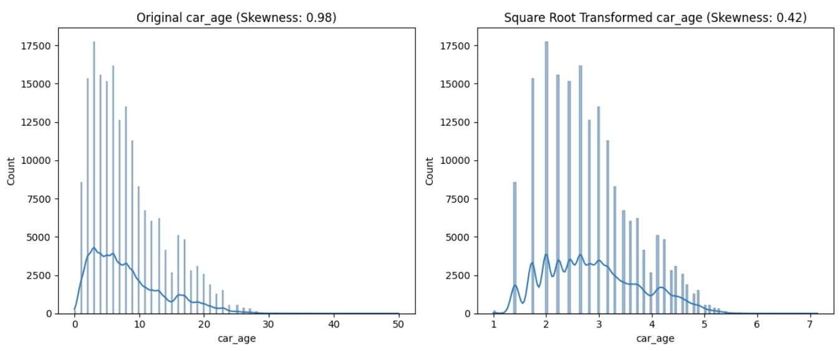
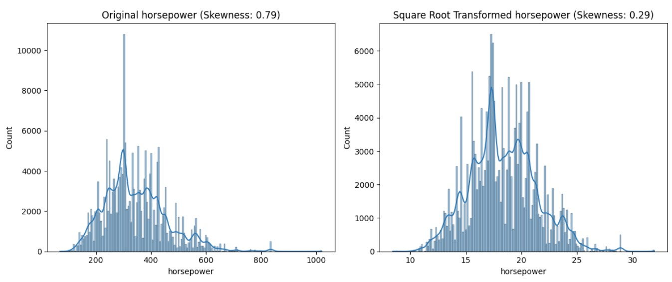
Square Root
Transformation

Slide 20
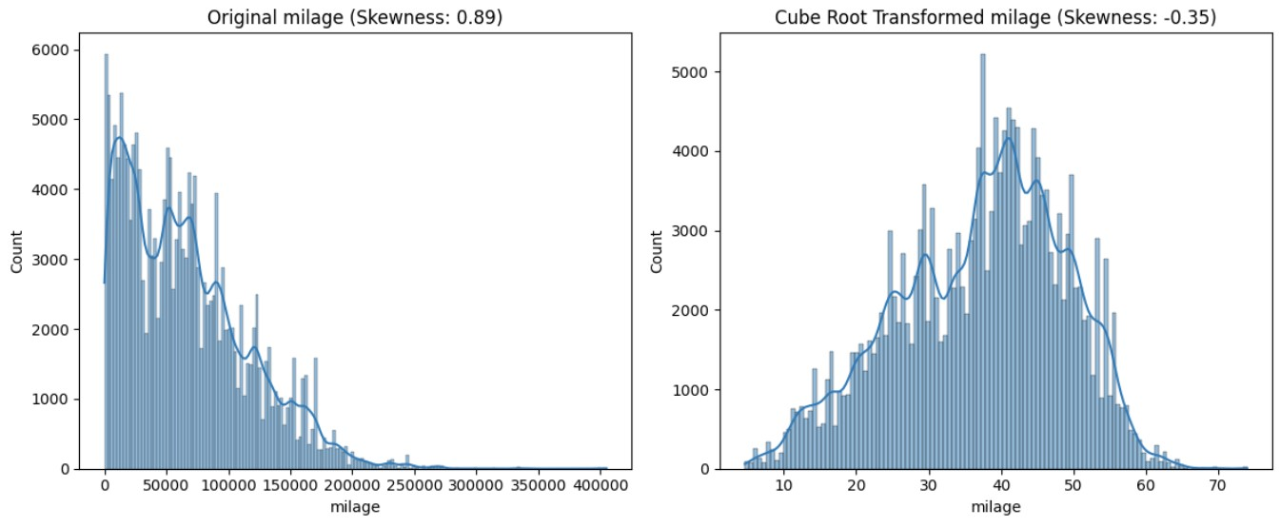
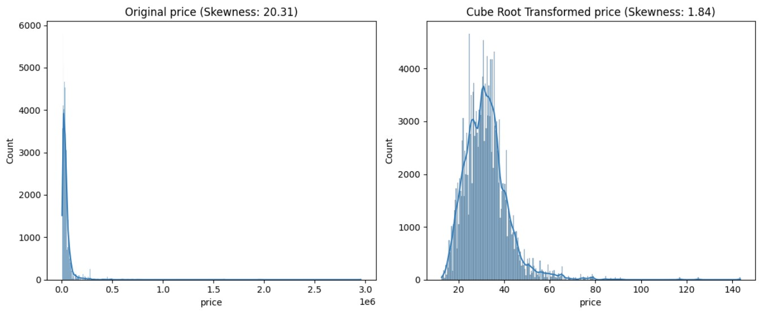
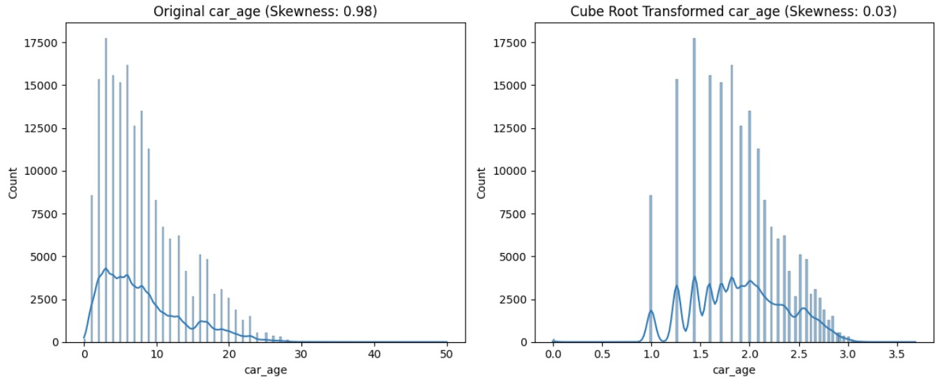
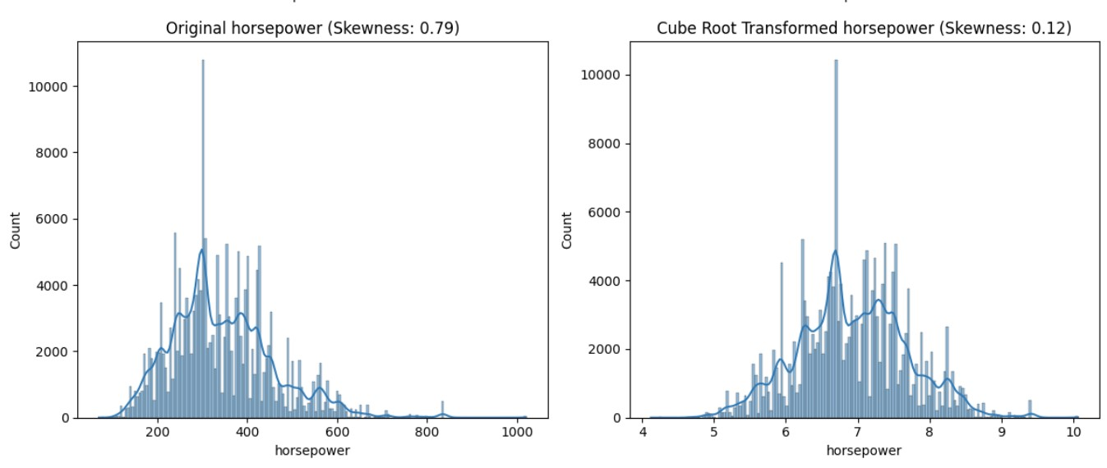
Cube Root
Transformation

Slide 21
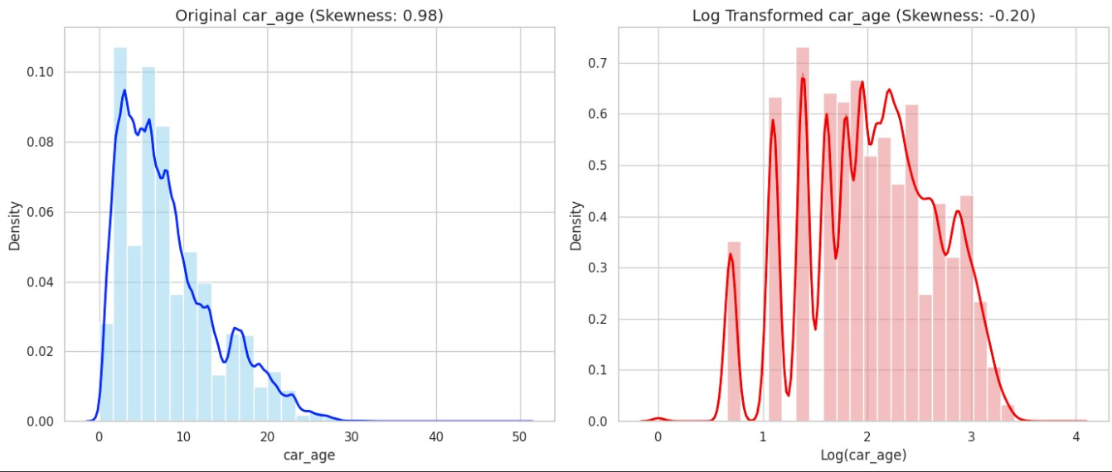
log transformation

Slide 22
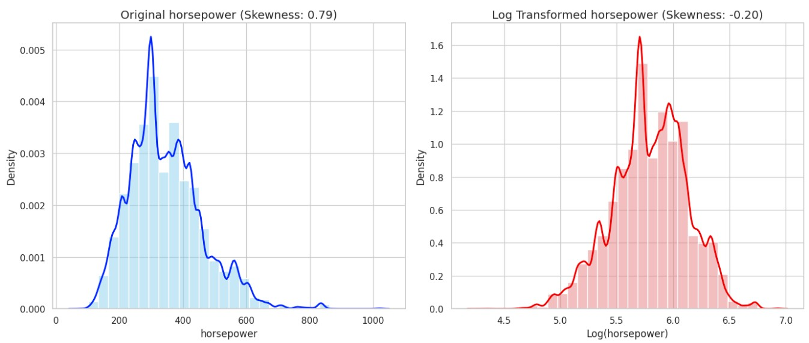
log transformation

Slide 23
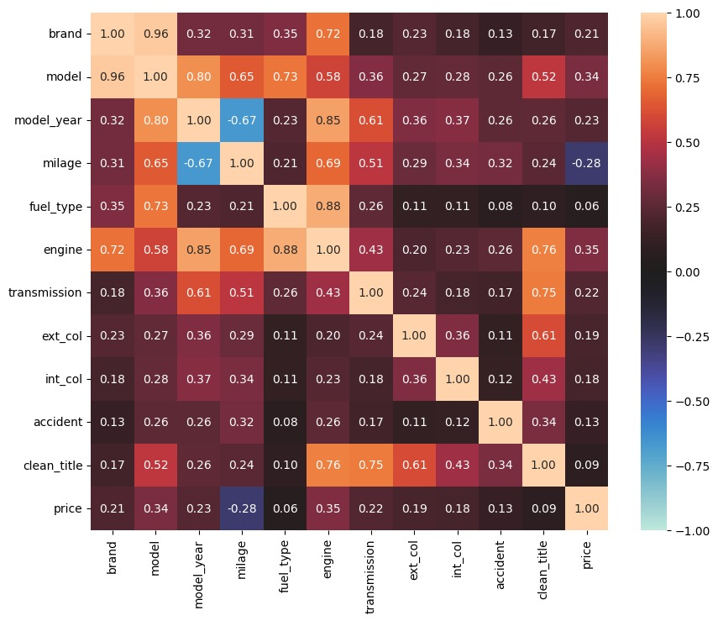
Correlation map

Slide 24

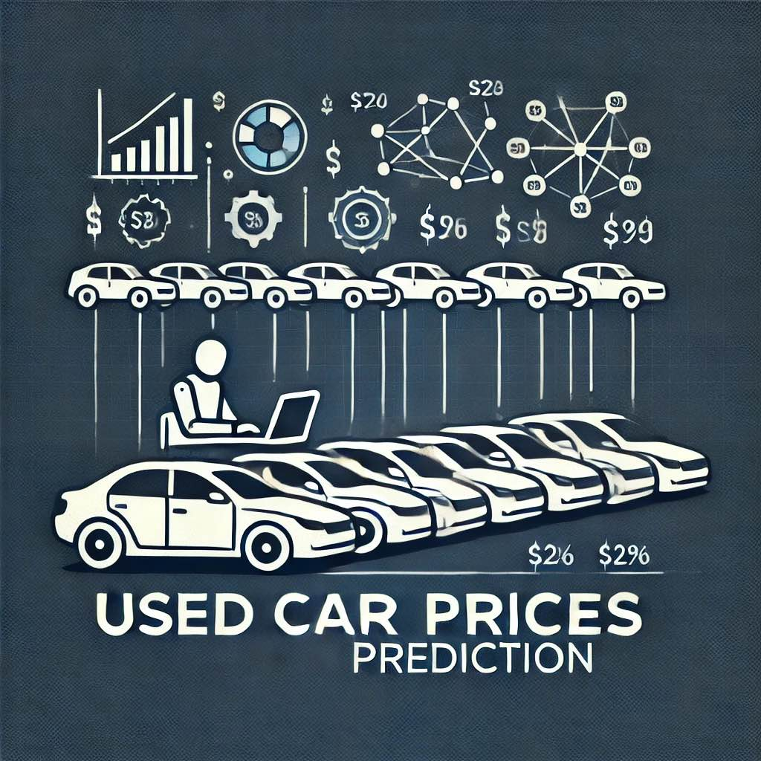
Preparing data for machine learning
for object features:
we used the label encoding method for
(brand and model )
other columns one hot encoding
for numerical features
normalization using min max scaler

Slide 25
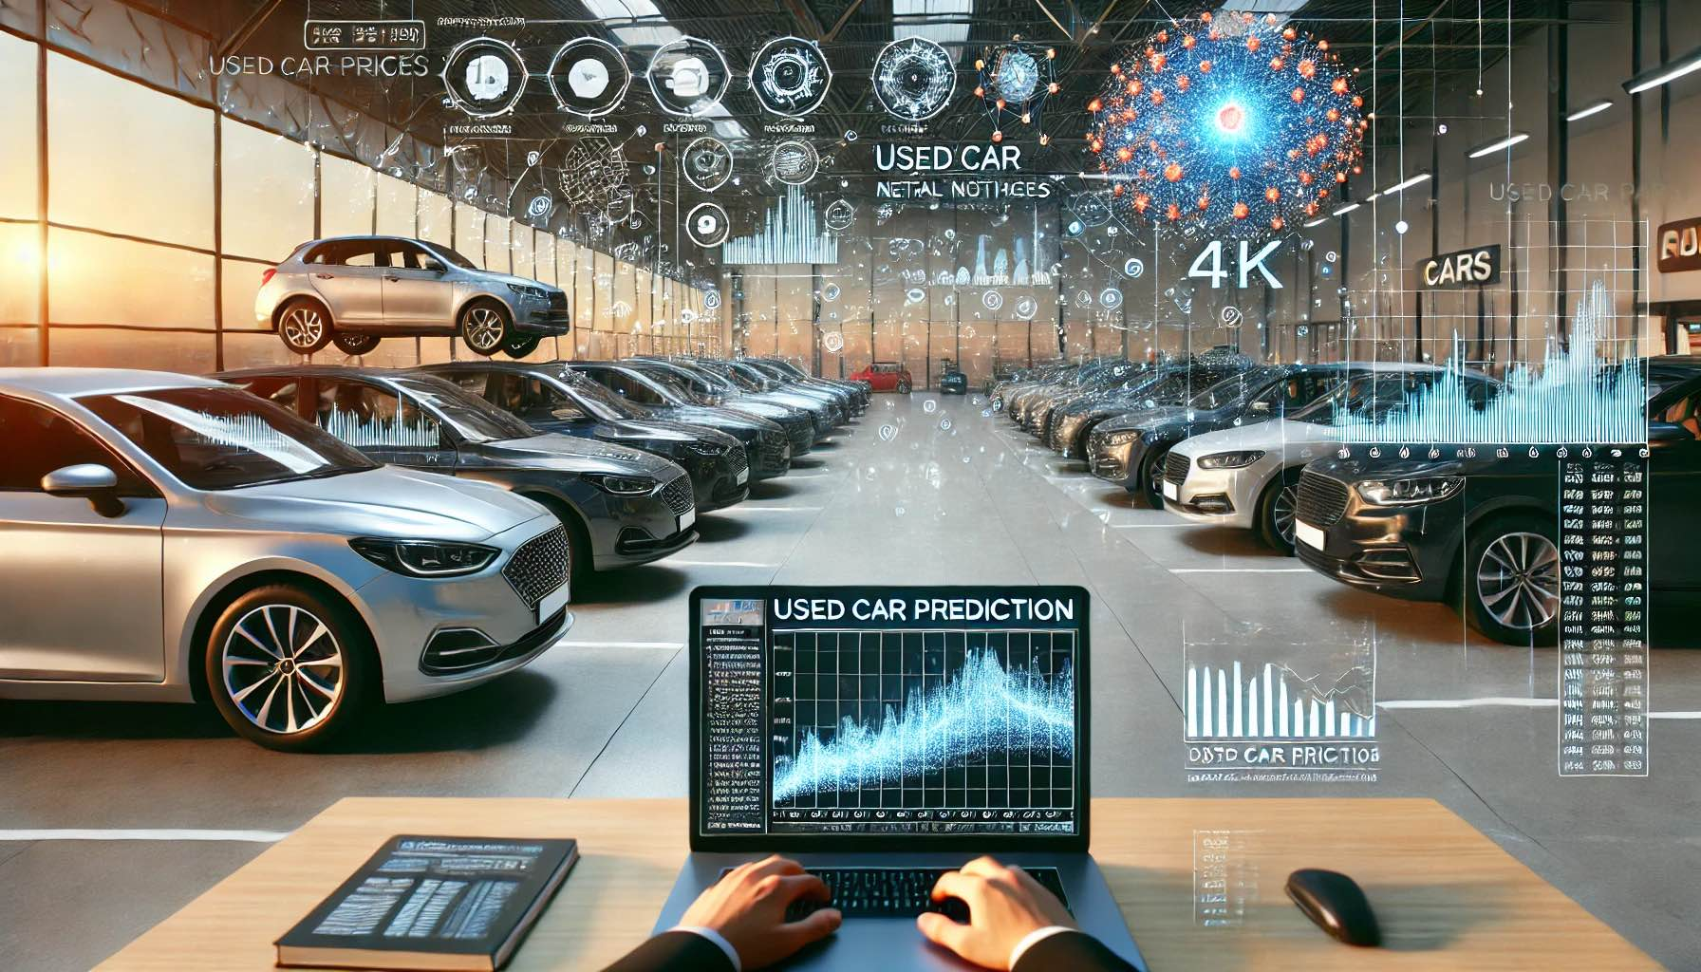
Models
we tested five machine-learning models
GradientBoostingRegressor
LightGB
LinearRegression
CatBoostRegressor
RandomForestRegressor

Slide 26
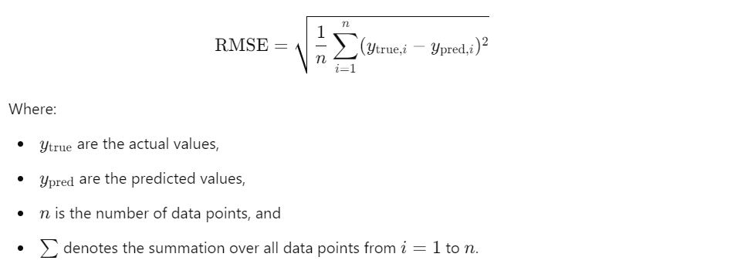
evaluation metrics

Slide 27
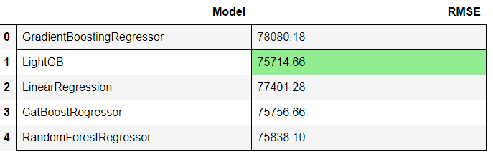
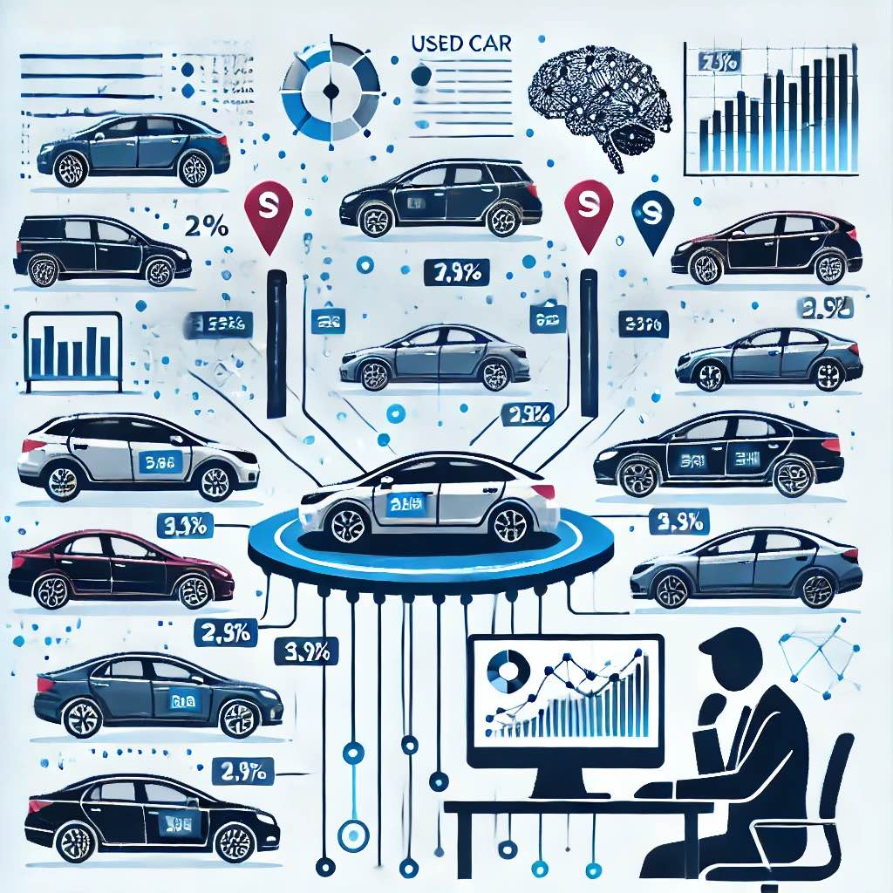
achieved scores

